Slide 1
"Tumor Grade Classification and Segmentation in Low-Grade Gliomas Using Deep Learning"
Presented by:
Alishbah Fahad
Sai Ganesh Reddy Katasani
Notes:
Good morning, Professor. Today, my groupmate, Ganesh, and I will be presenting our project titled 'Tumor Grade Classification and Segmentation in Low-Grade Gliomas Using Deep Learning.'

Slide 2
Problem Overview
1. Significance of Medical Imaging:
Essential for accurate diagnosis and treatment planning.
MRI scans are critical for analyzing brain tumors like low-grade gliomas (LGGs).
Challenges:
Small dataset sizes in medical imaging lead to:
Underfitting in deep learning models, resulting in low segmentation accuracy and inability to learn complex patterns.
Poor generalization to unseen data.
Subtle differences between tumor and normal tissues make segmentation and classification challenging.
3. Objective:
Develop a hybrid deep learning pipeline for:
Segmentation: Identifying tumor boundaries using U-Net.
Classification: Determining tumor presence using ResNet.
Notes:
Medical imaging plays a vital role in diagnosing and planning treatments for brain tumors, like low-grade gliomas. However, these tasks face significant challenges, including small dataset sizes leading to underfitting and difficulty in generalizing to new data. Tumors often exhibit subtle differences from normal tissues, making segmentation and classification particularly challenging. To address this, our objective was to develop a hybrid deep learning pipeline: U-Net for segmenting tumor boundaries and ResNet for classifying tumor presence.

Slide 3
Approach Overview
1. Pipeline Components:
U-Net for Segmentation:
Architecture: Encoder-decoder structure with skip connections.
Loss Function: Dice loss.
ResNet for Classification:
Architecture: Pre-trained ResNet50 fine-tuned for tumor classification.
2. Key Techniques:
Transfer Learning:
Used ResNet pre-trained on ImageNet to improve classification with limited data.
Data Augmentation:
Techniques: Rotation, flipping, resizing, color jittering.
Purpose: Expand dataset artificially to prevent overfitting.
Metrics:
Segmentation: Dice Coefficient.
Classification: Accuracy, F1-Score, AUC.
3. Workflow:
Input MRI scans → U-Net for segmentation → ResNet for classification.
Notes:
Our pipeline integrates U-Net and ResNet, with key techniques like transfer learning and data augmentation. Transfer learning utilizes a ResNet pre-trained on ImageNet for better performance despite limited data. Data augmentation, including rotation and flipping, artificially enlarges the dataset, improving model generalization. Evaluation metrics such as Dice Coefficient, Accuracy, F1-Score, and AUC measured performance across tasks.

Slide 4
Data and Preprocessing
Dataset Overview:
LGG Segmentation Dataset:
Brain MR images with manual FLAIR abnormality segmentation masks.
Sourced from The Cancer Imaging Archive (TCIA).
Based on 110 patients included in The Cancer Genome Atlas (TCGA) lower-grade glioma collection.
Includes MRI scans, genomic cluster data, and patient outcomes.
2. Data Splitting:
Training Set: 80% (Includes augmentation).
Testing Set: 20%.
Custom Dataset Classes:
Used ImageClinicalDataset class for combining MRI and clinical data with masks.
Notes:
We used the LGG Segmentation Dataset from the TCIA archive, consisting of brain MRI scans and manual segmentation masks for FLAIR abnormalities. This dataset includes data from 110 patients with genomic cluster information and clinical outcomes. We split the dataset into 80% for training, incorporating data augmentation, and 20% for testing. Additionally, we designed a custom ImageClinicalDataset class that combines MRI scans, clinical data, and masks into a structured format, ensuring the inputs were comprehensive and ready for training.

Slide 5
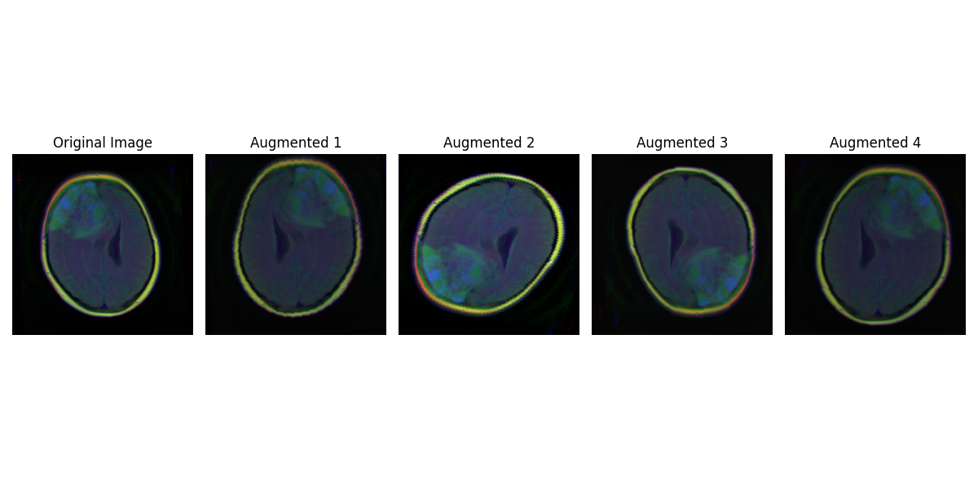
Data and Preprocessing
Preprocessing Techniques:
Training Data:
Random Rotation: Up to 20°.
Horizontal/Vertical Flipping.
Random Resized Cropping (Scale: 80%-100%).
Brightness and Contrast Adjustment.
Conversion to Tensor for PyTorch compatibility.
Testing Data:
Resizing to 256x256 pixels.
Conversion to Tensor.
4. DataLoader Configuration:
Batch Size: 8
Shuffle: Enabled for training to prevent underfitting.
Notes:
To address the small dataset challenge, we applied augmentation techniques to training data. These included random rotations, flips, cropping, and brightness adjustments, ensuring the model learned from diverse tumor representations. On the right, you can see an original MRI image and its augmented variations, demonstrating the diversity introduced through augmentation. This approach helps the model generalize better to unseen data during testing.
Testing data was resized for consistency and converted to tensors. Our DataLoader used a batch size of 8 and enabled shuffling to avoid patterns during training.

Slide 6
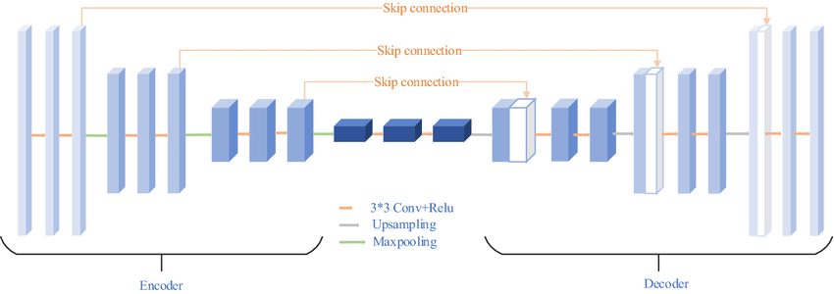
Model Architecture
U-Net for Segmentation:
Encoder-Decoder architecture designed to capture and reconstruct spatial information.
Encoders:
Three convolutional blocks with increasing depth (64, 128, and 256 channels).
Each block uses two convolutional layers, batch normalization, ReLU activation, and dropout.
Max pooling for downsampling.
Bottleneck:
Deepest layer, compressing and representing learned features.
Outputs 512 channels.
Decoders:
Three upsampling layers to restore resolution.
Skip connections concatenate features from corresponding encoder layers.
Output is a single-channel probability map using Sigmoid activation.
Notes:
To address the segmentation task, we implemented U-Net, a well-known architecture in medical imaging. It consists of an encoder-decoder structure, where the encoder extracts features by progressively increasing depth, and the decoder restores the resolution for precise segmentation.
We added dropout to the convolutional layers to address underfitting, improving the model's ability to generalize. Skip connections played a key role in retaining spatial details by connecting encoder and decoder layers.
The bottleneck acts as the deepest layer, compressing and representing the features learned by the model. Finally, the output is a single-channel probability map generated through Sigmoid activation.
The image represents a general U-Net architecture, not our specific implementation, but it helps to visualize the encoder-decoder structure and skip connections."

Slide 7
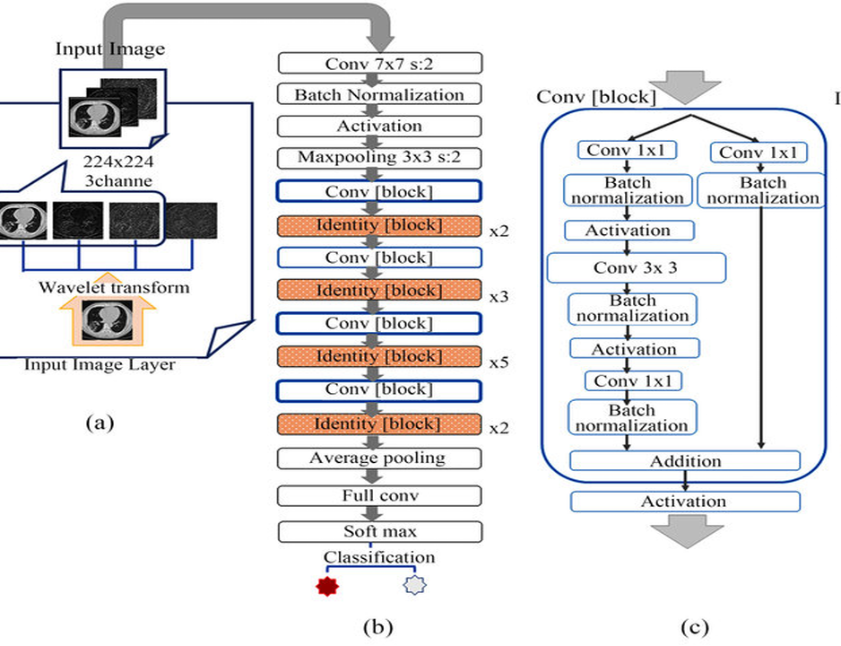
Model Architecture
2. ResNet for Classification:
Pretrained ResNet50 backbone for feature extraction.
Replaced fully connected layer with:
Layer 1: 128 units.
Layer 2: 64 units with batch normalization and dropout for regularization.
Final binary classification layer with Sigmoid activation.
Notes:
For the classification task, we used ResNet50, a pre-trained model known for its ability to efficiently extract features through residual connections. These connections help avoid the vanishing gradient problem and allow training of deeper networks.
We fine-tuned ResNet50 by replacing its fully connected layer with two custom layers: one with 128 units and another with 64 units, along with batch normalization and dropout for regularization. The final layer uses Sigmoid activation for binary classification, focusing on tumor presence detection rather than grade prediction.
The visual shown is a general representation of ResNet's architecture, illustrating how residual blocks enable feature extraction.

Slide 8
Loss Functions, Optimization, and Metrics
Loss Functions:
Segmentation Loss: Binary Cross-Entropy (BCE).
Used for pixel-level classification during segmentation.
Ensures accurate predictions for each pixel as tumor or non-tumor.
Classification Loss: Binary Cross-Entropy (BCE).
Used for predicting the presence of a tumor (0 = No Tumor, 1 = Tumor).
Optimization:
Optimizers: Adam Optimizer for both U-Net and ResNet models.
Benefits: Adaptive learning rates make it efficient and suitable for deep learning.
Evaluation Metrics:
Segmentation:
Dice Coefficient: Evaluates the overlap between predicted masks and ground truth masks.
Used to measure segmentation performance after training.
Classification:
Accuracy: Evaluates the percentage of correct classifications.
F1-Score: Balances precision and recall in binary classification.
AUC (Area Under the Curve): Measures the model’s ability to distinguish between tumor and non-tumor classes.
Notes:
For the segmentation task, we used Binary Cross-Entropy as the loss function, ensuring accurate pixel-level classification between tumor and non-tumor regions. To evaluate segmentation performance, we relied on the Dice Coefficient, which measures the overlap between predicted masks and ground truth masks.
For the classification task, Binary Cross-Entropy was also used to predict the presence or absence of a tumor. This choice aligns with our binary classification goal.
The Adam optimizer was employed for both models, leveraging its adaptive learning rate capability to achieve efficient training.
To evaluate model performance comprehensively, we utilized Dice Coefficient for segmentation, and Accuracy, F1-Score, and AUC for classification. These metrics ensured a balanced assessment of both tasks, highlighting strengths and areas for improvement.

Slide 9
Experimental Results
Metric | Before Fine-Tuning | After Fine-Tuning
Segmentation Dice | 0.0711 | 0.3854
Segmentation Loss | 0.0375 | 0.0374
Classification Accuracy | 88.13% | 87.63%
Classification F1-Score | 0.8597 | 0.8429
Classification AUC | 0.9543 | 0.95
Notes:
Before fine-tuning, the segmentation Dice Coefficient was 0.0711. Fine-tuning increased it to 0.3854, showcasing improved segmentation accuracy. Classification metrics like Accuracy and AUC remained high but showed slight declines post-fine-tuning. Augmentation and loss functions played a pivotal role in achieving these results.

Slide 10
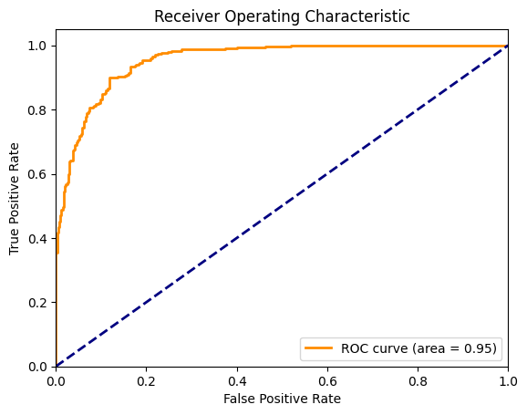
Experimental Results
Notes:
This ROC curve demonstrates the model's classification ability, achieving an impressive AUC of 0.95, highlighting its strong performance in distinguishing between tumor and non-tumor cases.

Slide 11
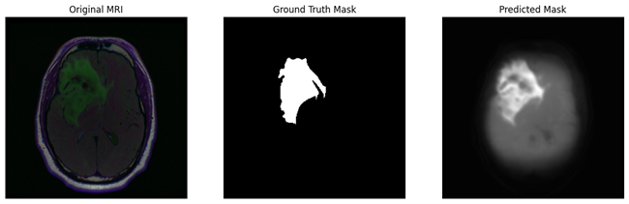
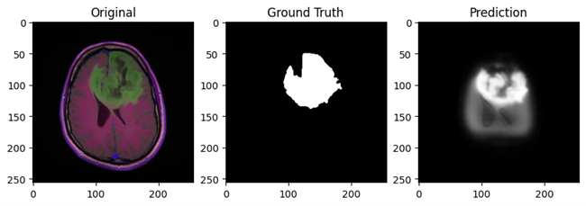
Experimental Results
Before Fine-Tuning:
After Fine-Tuning:
Notes:
Here we observe a improvement in segmentation predictions post-fine-tuning, with clearer tumor boundaries and higher alignment with ground truth masks, as reflected in the Dice Coefficient increase from 0.0711 to 0.3854.
However, the post-fine-tuning results still have room for improvement, as some tumor regions are over-segmented or under-segmented compared to the ground truth.

Slide 12
Conclusion
1. Conclusion:
Developed a two-stage pipeline integrating U-Net for segmentation and ResNet for classification.
Fine-tuning improved segmentation results with a Dice coefficient rising from 0.0711 to 0.3854.
Classification performed well overall, though fine-tuning caused a minor drop in accuracy and F1-score.
The proposed data augmentation and loss function strategies effectively addressed the challenges posed by the limited dataset.
Challenges Faced:
Dataset constraints affected generalization.
Computational limits prolonged training time, restricting further experimentation.
3. Lessons Learned:
Fine-tuning improves segmentation but can introduce trade-offs in multitask models.
Proper architectural design and augmentation strategies are critical in medical imaging tasks.
Notes:
In this project, we developed a two-stage pipeline combining U-Net for segmentation and ResNet for classification of gliomas.
Fine-tuning led to improvement in segmentation performance, increasing the Dice Coefficient from 0.0711 to 0.3854. However, we observed a minor decline in classification metrics like accuracy and F1-score.
Challenges faced included dataset constraints, which limited generalization, and computational limitations that restricted further experimentation.
The lessons learned highlight the critical role of fine-tuning, balanced trade-offs in multitask models, and the importance of designing tailored architectures and augmentation strategies for medical imaging tasks.

Slide 13
Future Work
Incorporate advanced data augmentation techniques such as synthetic data generation using GANs.
Explore multi-task learning frameworks that jointly optimize segmentation and classification.
Improve model generalizability using domain adaptation for unseen data.
Leverage distributed or cloud computing to overcome computational constraints and enable extensive experimentation.
Notes:
Future work includes exploring GANs for synthetic data generation, domain adaptation for better generalization, and multi-task learning frameworks to jointly optimize segmentation and classification. Leveraging distributed computing could overcome computational limits and enable more experiments.

Slide 14
THANK YOU
Notes:
Thank you for your time.

